Slide 1
Discrete Probability Distributions
The Poisson Probability Distribution

Slide 2
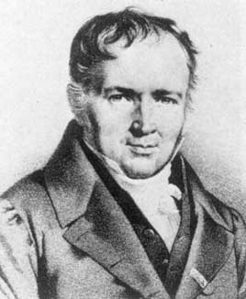
The distribution was derived by the French mathematician Siméon Poisson in 1837,
The first application was the description of the number of deaths by horse kicking in the Prussian army.

Slide 3
Poisson distribution
In binomial when n is large and p is small.
Simeon Denis Poisson(1781-1840) gave a theorem: Parameter λ = np = expected value
here e =2.71828
Mean=E(x)=λ var(x)= λ

Slide 4
Poisson distribution: Assumptions
An experiment is called Poisson experiment if it has the following properties:
The probability of observing 1 success is directly proportional to the length of the time interval Δt.
i.e. Pr(1 success) ≈ λΔt for some constant λ
2. The probability of two or more successes in any sufficiently small subinterval is 0.
i.e. Pr(>=2 success) ≈ 0 Pr(0 success) ≈ 1- λΔt

Slide 5
Poisson distribution: Assumptions
3. Stationarity: The probability of success is the same for any two intervals of equal length
i.e. probability equal to the size of the region.
Time : t
p₁ | p₂ |  | --- |  |  |  | P_{n}
Probability : p₁=p₂=…….. =p_{n}

Slide 6
Poisson distribution: Assumptions
4. Independence: The number of successes in any interval is independent of the number of successes in any other interval provided the intervals are not overlapping.
Time : t
t₁ | t₁ |  |  |  |  |  | t₁
N₁ | n₂ |  |  |  |  |  | n_{n}
n₁, n₂, …….., n_{n are independent}

Slide 7
Poisson Distribution
Poisson distribution: Formal Definition
Poisson distribution is the probability distribution that results from a poisson experiment.
Let x be the number of events occurring within a given time interval in a poisson process, then this is a random variable and its probability distribution is
λ is the shape parameter which indicates the average number of events over a time period, not per unit time.

Slide 8
Poisson distribution: Advantage
No need to know n and p;
Estimate the parameter λ from data.
Death reports by horse-kick from 10 cavalry corps over a period of 200 years by Prussian officials.
X= Number of deaths | Frequencies (year)
0 | 109
1 | 65
2 | 22
3 | 3
4 | 1
Total | 200

Slide 9
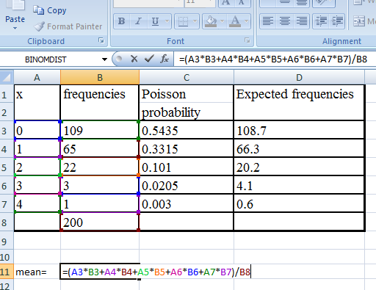
Poisson distribution: calculation
Excel calculation: Calculate mean to find λ ( lamda )

Slide 10
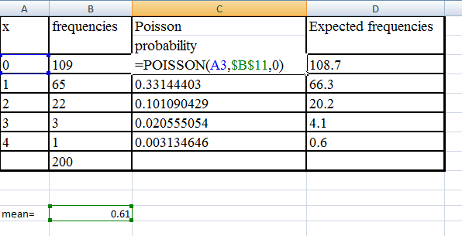
Poisson distribution: Calculation
Excel calculation: Calculate Poisson probability for each cell.

Slide 11
Poisson distribution: Calculation
x | frequencies | Poisson probability | Expected frequencies
0 | 109 | .5435 | 108.7
1 | 65 | .3315 | 66.3
2 | 22 | .101 | 20.2
3 | 3 | .0205 | 4.1
4 | 1 | .003 | 0.6
 | 200
Conduct a chi-square test to see if Poisson model is compatible with data or not.
Degree of freedom is 4-1-1 = 2.
Pearson’s statistic = .304;
P-value is .859
Accept null hypothesis, data compatible with model

Slide 12
Example: A Poisson Process
Suppose the number of deaths from typhoid fever over a 1-year period is Poisson distributed with parameter μ =λt= 4.6.
What is the probability distribution of the number of deaths over a 6-month period?
A 3-month period?
Sol.
1. λ=4.6*.5=2.3
If random variable x follows poisson distribution

Slide 13
Example: A Poisson Process

Slide 14
Example: A Poisson Process
Suppose the number of deaths from typhoid fever over a 1-year period is Poisson distributed with parameter μ =λt= 4.6.
What is the probability distribution of the number of deaths over a 6-month period? Ans 2.3
A 3-month period?
Sol.
2. λ=4.6*0.25=1.15
If random variable x follows poisson distribution

Slide 15
Example: A Poisson Process
Average number of homes sold by a company is 2 homes per day. What is the probability that exactly 3 homes will be sold tomorrow?
Sol. λ=2.0 x=3
If random variable x follows poisson distribution

Slide 16
Example: Computing Poisson Probabilities
The Food and Drug Administration sets a Food Defect Action Level (FDAL) for various foreign substances that inevitably end up in the food we eat and liquids we drink.
For example, the FDAL level for insect filth in chocolate is 0.6 insect fragments (larvae, eggs, body parts, and so on) per 1 gram.
Determine the mean number of insect fragments in a 5 gram sample of chocolate.
What is the standard deviation?

Slide 17
Assumptions: Why poisson?
For a sufficiently small interval, the probability of two successes is 0.
The probability of insect filth in one region of a candy bar is equal to the probability of insect filth in some other region of the candy bar.
The number of successes in any random sample is independent of the number of successes in any other random sample.

Slide 18
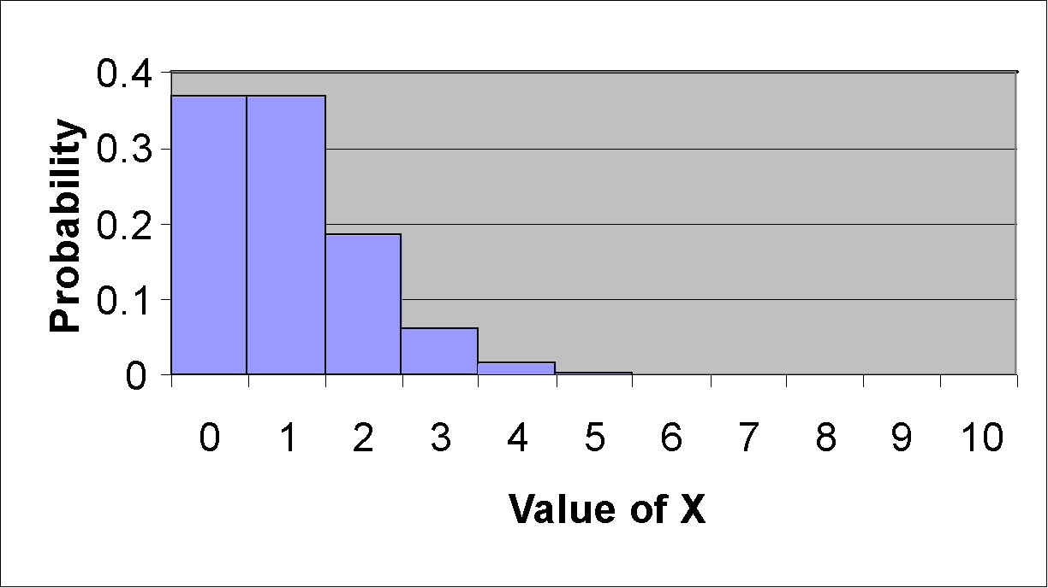
Probability Histogram of a Poisson Distribution with λ = 1

Slide 19
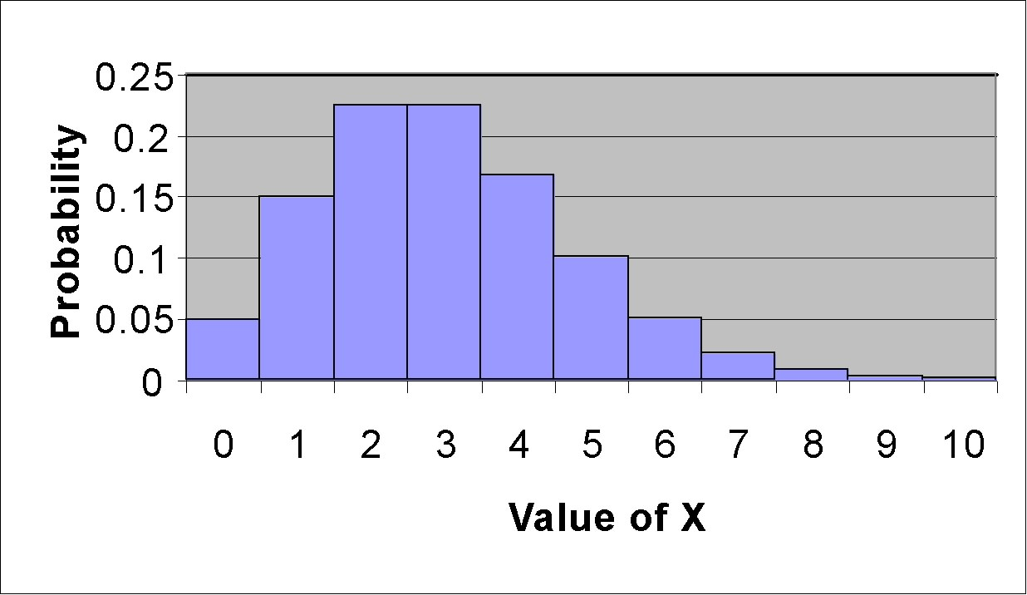
Probability Histogram of a Poisson Distribution with λ = 3

Slide 20
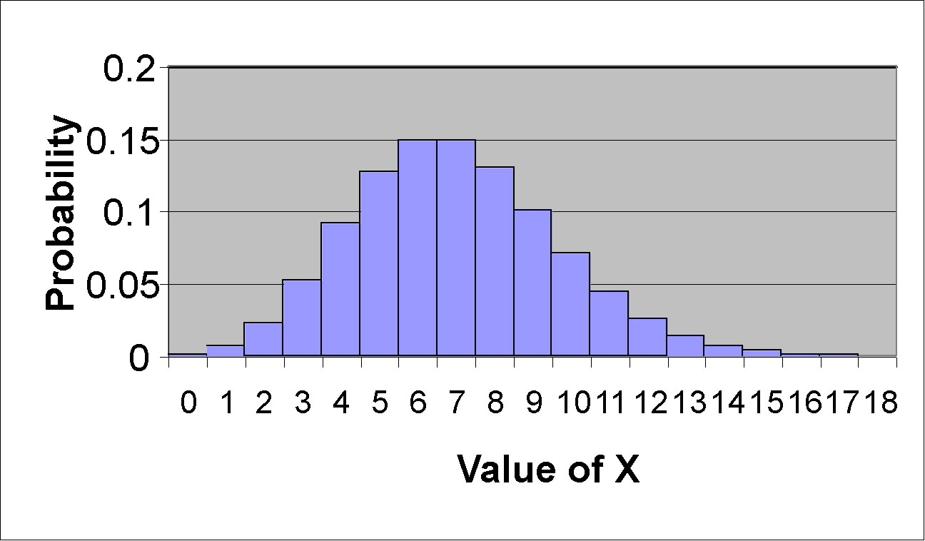
Probability Histogram of a Poisson Distribution with λ = 7

Slide 21
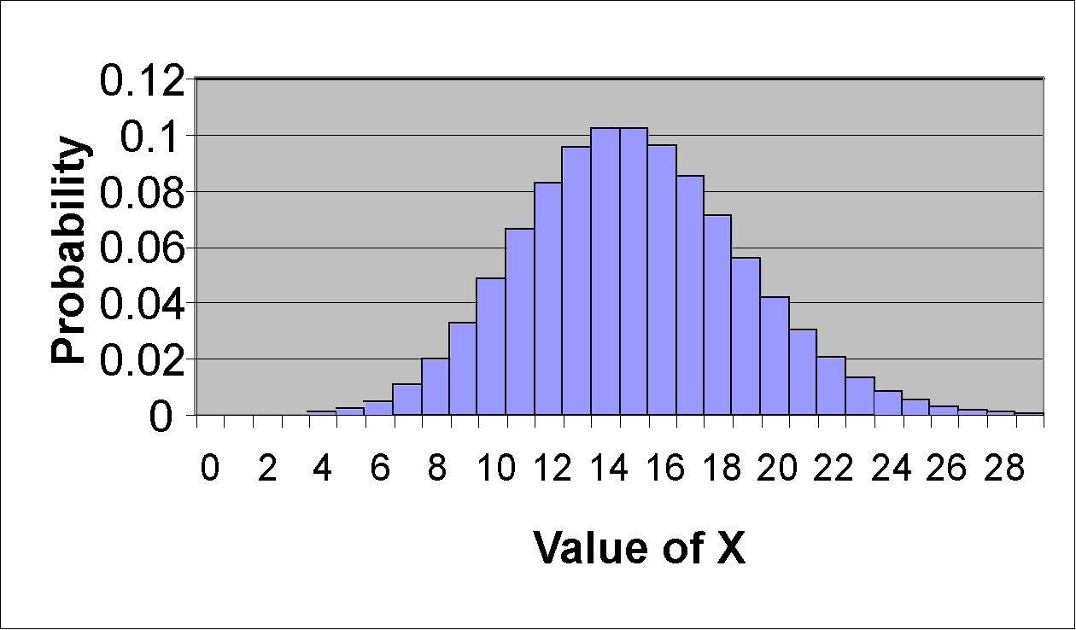
Probability Histogram of a Poisson Distribution with λ = 15

Slide 22
Example: Poisson Particles
In 1910, Ernest Rutherford and Hans Geiger recorded the number of α-particles emitted from a polonium source in eighth-minute (7.5 second) intervals. The results are reported in the table on the next slide. Does a Poisson probability function accurately describe the number of α-particles emitted?
Source: Rutherford, Sir Ernest; Chadwick, James; and Ellis, C.D.. Radiations from Radioactive Substances. London, Cambridge University Press, 1951, p. 172.

Slide 23
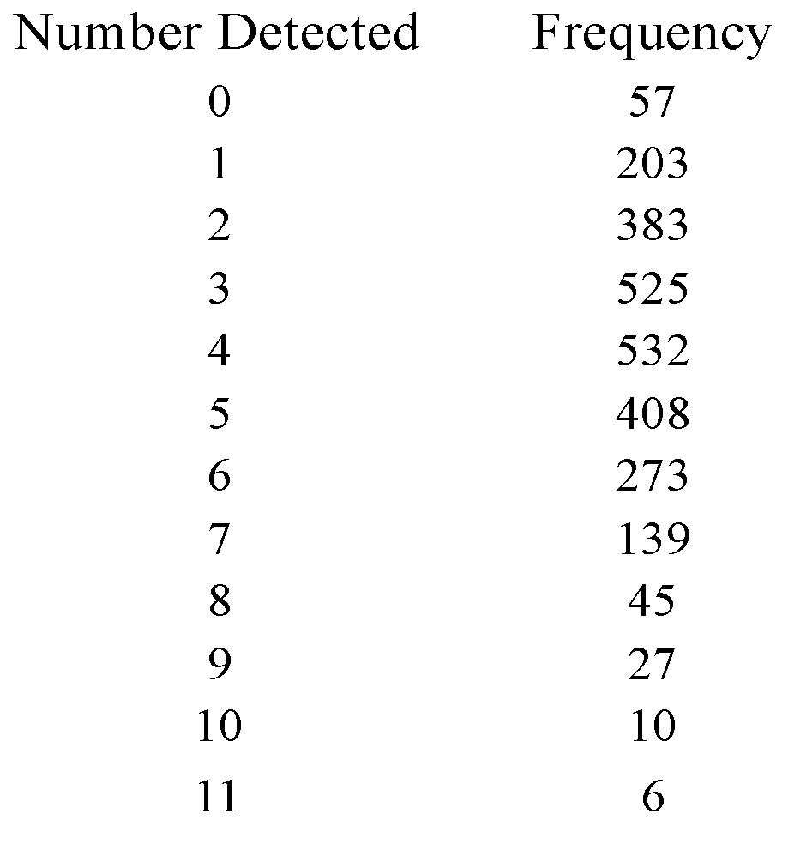
Poisson distribution: Calculation

Slide 24
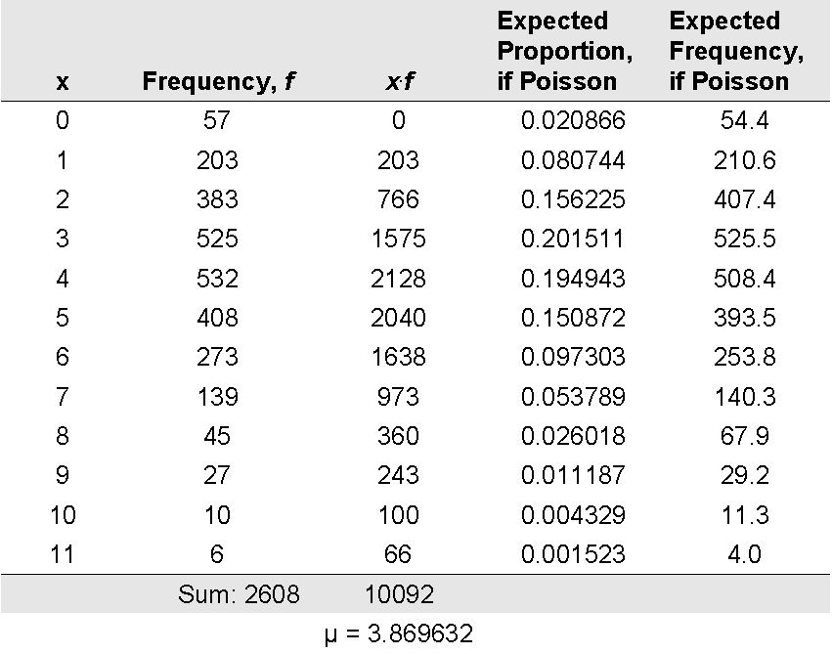
Poisson distribution: Calculation

Slide 25
Results from calculation
Pearson’s chi-squared statistics = 12.955;
d.f.=12-1-1=10
Poisson parameter = 3.87,
P-value between .95 and .975.
Accept null hypothesis : data are compatible with Poisson model

Slide 26
Poisson Approximation to the Binomial Distribution
The binomial distribution with large n and small p can be accurately approximated by
a Poisson distribution with parameter μ = np.

Slide 27
Example
According to the U.S. National Center for Health Statistics, 7.6% of male children under the age of 15 years have been diagnosed with Attention Deficit Disorder (ADD). In a random sample of 120 male children under the age of 15 years, what is the probability that at least 4 of the children have ADD?

Slide 28
Example
Suppose 6 of 15 students in a grade-school class develop influenza, whereas 20% of grade-school students nationwide develop influenza. Is there evidence of an excessive number of cases in the class? That is, what is the probability of obtaining at least 6 cases in this class if the nationwide rate holds true?
What is the expected number of students in the class who will develop influenza?
What is the probability of obtaining exactly 6 events for a Poisson distribution with parameter μ = 4.0?
What is the probability of obtaining at least 6 events for a Poisson distribution with parameter μ = 4.0?
What is the expected value and variance for a Poisson distribution with parameter μ = 4.0?

